Slide 1
TorontoCity: Seeing the World with a Million Eyes

Slide 2
Abstract
In this paper we introduce the TorontoCity benchmark, which covers the full greater Toronto area (GTA) with 712.5km2 of land, 8439km of road and around 400,000 buildings.
Our benchmark provides different perspectives of the world captured from airplanes, drones（无人机） and cars driving around the city.
Manually labeling such a large scale dataset is infeasible. Instead, we propose to utilize different sources of high-precision maps to create our ground truth.
Towards this goal, we develop algorithms that allow us to align all data sources with the maps while requiring minimal human supervision.
We have designed a wide variety of tasks including building height estimation (reconstruction), road centerline and curb extraction, building instance segmentation, building contour（轮廓） extraction (reorganization), semantic labeling and scene type classiﬁcation (recognition).
Our pilot study shows that most of these tasks are still difﬁcult for modern convolutional neural networks.

Slide 3
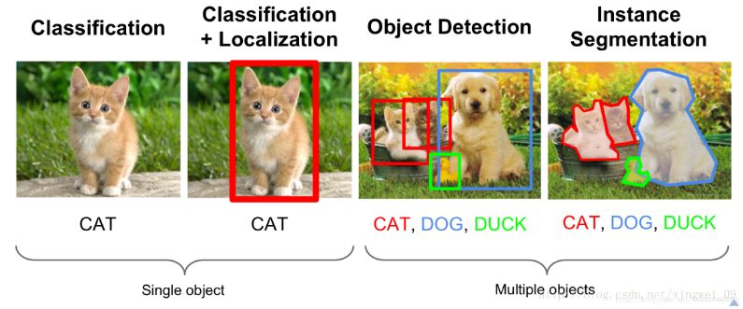
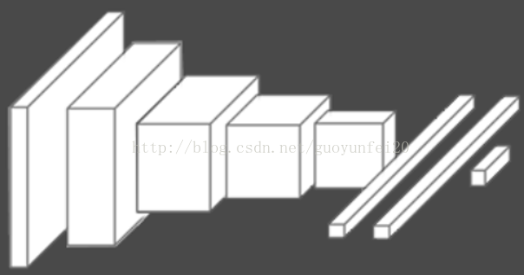
1. Introduction
In recent times, a great deal of effort has been devoted to creating large scale benchmarks.
ImageNet [9] made it possible to train large convolutional neural networks
ImageNet项目是一个用于视觉对象识别软件研究的大型可视化数据库。超过1400万的图像URL被ImageNet手动注释，以指示图片中的对象;在至少一百万个图像中，还提供了边界框
Alex-Net [16]： initiating the deep learning revolution in computer vision in 2012
Alex-Net 是2012年被提出的一种卷积神经网络结构，可以利用ImageNet上的数据集进行训练，达到分类效果

Slide 4
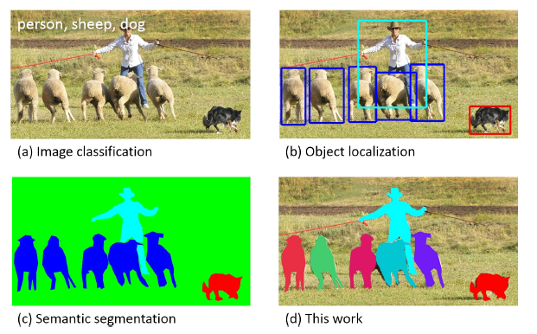
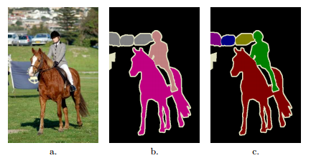
1. Introduction
PASCAL VOC [11] ： Pascal VOC 是一个非常流行的数据集，用于构建和评估图像分类、对象检测和分割的算法（20个类别）
Microsoft COCO [18]：数据集以scene understanding为目标，主要从复杂的日常场景中截取，图像中的目标通过精确的segmentation进行位置的标定。Coco有91个类别，比ImageNet规模小，但是比PASCAL VOC有更多类和图像

Slide 5
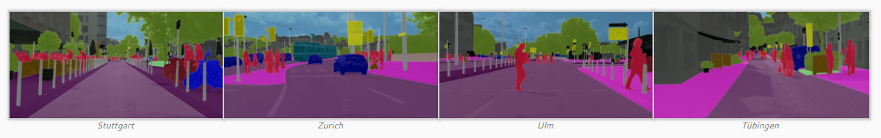
1. Introduction
KITTI [12]：是目前国际上最大的自动驾驶场景下的计算机视觉算法评测数据集。用于评测目标（机动车、非机动车、行人等）检测、目标跟踪、路面分割等计算机视觉技术在车载环境下的性能。
Cityscapes [8]：由奔驰主推，提供无人驾驶环境下的图像分割数据集。用于评估视觉算法在城区场景语义理解方面的性能。
However, current large scale datasets suffer from two shortcomings：
First, they have been captured by a small set of sensors with similar perspectives of the world, e.g., internet photos for ImageNet
Second, they do not contain rich semantics and 3D information at a large-scale

Slide 6
1. Introduction
Achievement:
we have created the Toronto City benchmark, covering the full greater Toronto area (GTA) with 712.5km2 of land, 8439km of road and around 400,000 buildings.
Dataset -- different views of the city:
We have gathered a wide range of views of the city:
From the overhead perspective, we have aerial images captured during four different years as well as LIDAR from airborne.
From the ground, we have HD panoramas as well as stereo, Velodyne LIDAR and Go-pro data captured from a moving vehicle driving around in the city.
We are also augmenting the dataset with a 3D camera as well as imagery captured from drones.

Slide 7
1. Introduction
Challenge:
One of the main challenges in creating TorontoCity was aligning the maps to all data sources such that the maps can produce accurate ground truth. While the aerial data was perfectly aligned, this is not the case of the panoramas where geolocalization is fairly noisy.
Solution:
To alleviate this problem, we have created a set of tools which allow us to reduce the labeling task to a simple veriﬁcation process, speeding up labeling, thus making TorontoCity possible.
Conclusion:
We perform a pilot study using the aerial images captured in 2011 as well as the ground panoramas. Our experiments show that:
State-of-the-art methods work well on some tasks, such as semantic segmentation and scene classiﬁcation.
However, tasks such as instance segmentation, contour extraction and height estimation remain an open challenge.

Slide 8
1. Introduction
Future:
We believe our benchmark provides a great platform for developing and evaluating new ideas, particularly techniques that can leverage different view points of the world.
Plan:
We plan to extend the current set of benchmarks in the near future with tasks such as building reconstruction, facade parsing, tree detection and tree species classiﬁcation as well as trafﬁc lights and trafﬁc sign detection, for which our maps provide accurate ground truth.

Slide 9
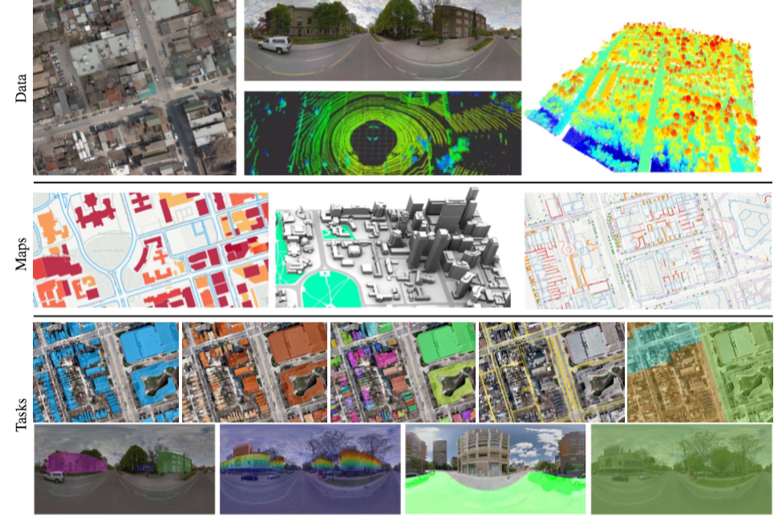
1. Introduction

Slide 10
2.Related Work
Automatic mapping, reconstruction and semantic labeling from urban scenes have been an important topic for many decades. Several benchmarks have been proposed to tackle subsets of these tasks:
KITTI [12] is composed of stereo（立体） images and LIDAR data collected from a moving vehicle, and evaluates SLAM, optical ﬂow, stereo and road segmentation tasks.
Cityscapes[8] focuses on semantic and instance annotations of images captured from a car.
Aerial KITTI[21] augments the KITTI dataset with aerial imagery of a subset of Karlsruhe to encourage reasoning of semantics from both ground and bird’s eye view.
The photometry community has developed several benchmarks towards urban scene understanding [15,24,30, 25, 20]:
TUM-DLR [15] and ISPRS Multi-Platform [24] benchmarks contain imagery captured through multiple perspectives from UAV（无人机）, satellite images and handheld cameras.
Oxford RobotCar contains lidar point cloud and stereo images captured from a vehicle [20].

Slide 11
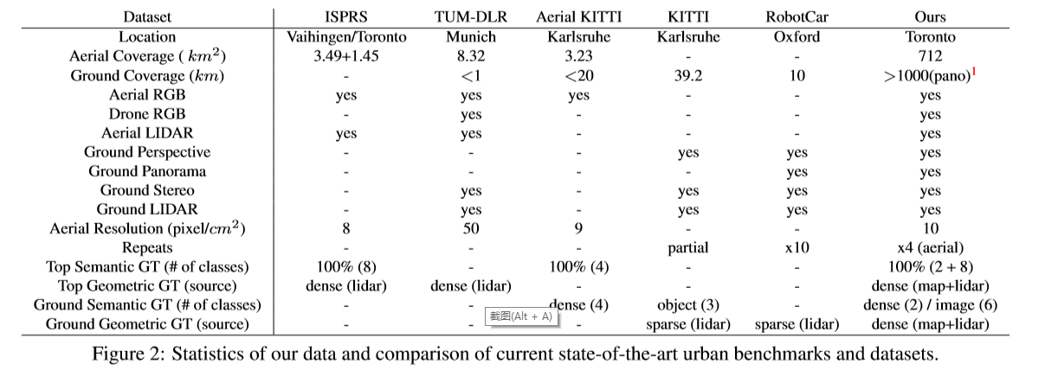
2.Related Work

Slide 12
2.Related Work
Shortcomings:
However, these benchmarks do not offer any semantic ground-truth for benchmarking purposes.
Perhaps the most closely related dataset to ours is the ISPRS Urban classiﬁcation and building reconstruction benchmark[30], where the task is to extract urban object, such as building, road and trees from both aerial images and airborne laserscanner point clouds.
However, this dataset has a relatively small coverage and does not provide ground-view imagery. Incontrast, TorontoCity is more than two orders of magnitude bigger.
Others:
A popular alternative is to use synthetic（合成） data to generate large scale benchmarks [3, 5, 26, 29, 31, 13, 6, 28]. Through 3D synthetic scenes and photo-realistic renderers large-scale datasets can be easily created.
To date, however, these datasets have been focused on a single view of the world. Our input is real-world imagery, and the large-scale 3D models are a high-ﬁdelity modeling of the real world rather than a synthetic scene.

Slide 13
3.TorontoCity at a Glimpse
3.1. Dataset
Fig. 1 depicts some of the data sources that compose our dataset. We now describe the data in more details and refer the reader to Fig. 2 for a comparison against existing datasets.
Panoramas:
We downloaded Google Streetview panoramas [2] that densely populate the GTA. In addition, we crawled the associated metadata（元数据）, including the geolocation, address and the parameters of the spherical projection, including pitch（俯仰角）, yaw（偏航角） and tilt angles（倾斜角）.
Aerial Imagery:
We use aerial images with full coverage of the GTA taken in 2009, 2011, 2012 and 2013. Our aerial images have four channels (i.e., RGB and Near infrared（近红外）. As is common practice in remote sensing [4], we projected each image to the Universal Transverse Mercator (UTM)17 zone in the WGS84 geodetic datum and tiled the area to 500×500m2 images without overlap.

Slide 14
3.TorontoCity at a Glimpse
3.1. Dataset
Airborne LIDAR:
We also exploit airborne LIDAR data captured in 2008 with a Leica ALS sensor with a resolution of 6.8 points per m2. The total coverage is 22 km2. All of the points are also geo-referenced and projected to the UTM17 Zone in WGS84 geodetic datum.
Car setting:
Our recording platform includes a GoPro Hero 4 RGB camera, a Velodyne HDL-64E LIDAR and a PointGray Bumblebee3 Stereo Camera mounted on top of thevehicle. All the sensors are calibrated and synchronized with a Applanix POS LV positioning system to record realtime geo-location and orientation information. We have driven this platform for around 90km, which includes repeats of the same area.

Slide 15
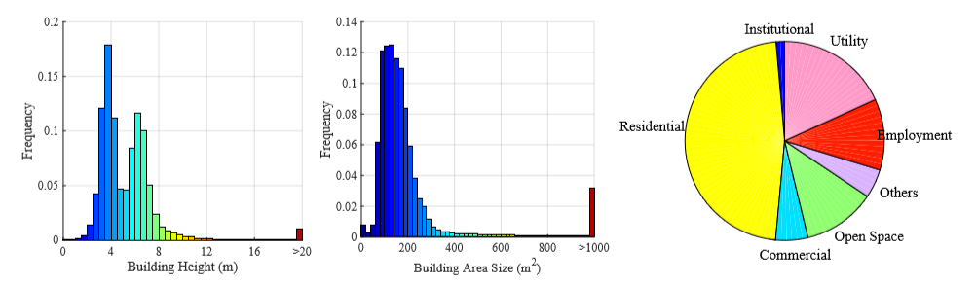

3.TorontoCity at a Glimpse
3.2.Maps as Annotations
Buildings:
The TorontoCity dataset contains 400,000 3D buildings covering the full GTA. As shown in Fig. 2, the buildings are very diverse, with the tallest being the CN Tower with $443m$ of elevation. The mean height of each building is $4.7m$, and the mean building area is $148mm^{2}$. In contrast, the largest building has an area $120,000m^{2}$.

Slide 16
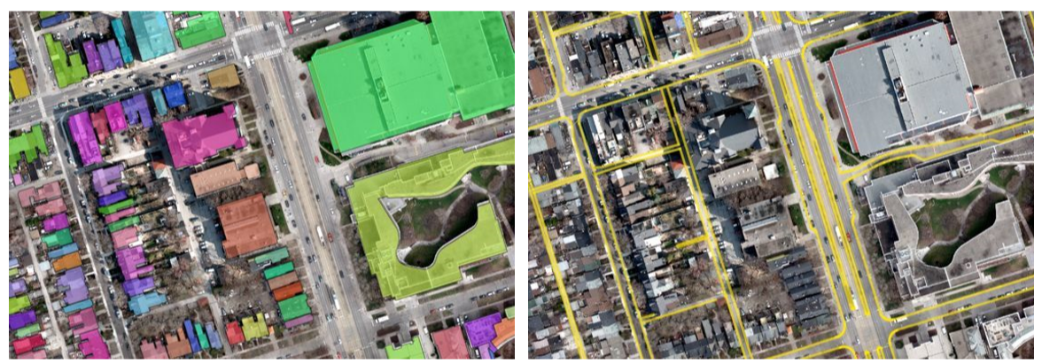
3.TorontoCity at a Glimpse
3.2.Maps as Annotations
Roads: Our maps contain very accurate polylines representing streets, sidewalks, rivers and railways within the GTA. Each line segment is described with a series of attributes such as name, road category and address number range. Road intersections are explicitly encoded as intersecting points between polylines.
Urban Zoning: Our maps contain government zoning information on the division of land into categories. This zoning includes categories such as residential, commercial, industrial and institutional.

Slide 17
3.TorontoCity at a Glimpse
3.2.Maps as Annotations
Additional data: We also have cartographic information with full coverage of the GTA. For instance, we have the location of all the poles, trafﬁc lights, street lights and street trees with meta-information for each. The meta-information includes the height of the pole/trafﬁc light, type of model of each street lights, trunk radius and species of each trees. We plan to exploit this in the near future.

Slide 18
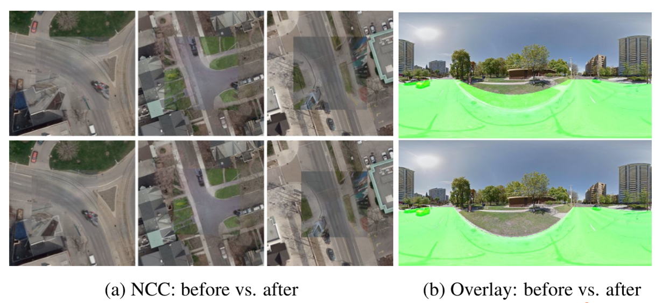
4.Maps for Creating Large Scale Benchmarks
4.1.Aligning Maps with All Data Sources
The aerial images we employed are already perfectly aligned with the maps. This, however, is not the case for the panoramas. As noted in [7], the geolocalizaiton error is up to 5m with an average of 1.5m. As a consequence, projecting our maps will not generate good ground truth due to the large misalignments as shown in Fig.4.

Slide 19
4.Maps for Creating Large Scale Benchmarks
To handle this issue, we design an alignment algorithm that exploits both aerial images and maps. Their information is complementary, as aerial images give us appearance, while maps give us sparse structures (e.g., road curves).
Steps:
Project: We ﬁrst rectify the panoramas by projecting them onto the ground-plane. We extract a 400 × 400 m ground plane region with 10cm/pixel resolution and parameterize the alignment with three degrees of freedom representing the camera’s offset.

Slide 20
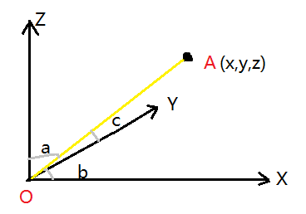
4.Maps for Creating Large Scale Benchmarks

Slide 21
4.Maps for Creating Large Scale Benchmarks
Coarse alignment:
We obtain a coarse alignment by maximizing a scoring function that compromises between appearance matching and a regularizer. In particular, we use normalized cross correlation (NCC) as our appearance matching term and a Gaussian prior with mean (0,0,2.5)m and diagonal covariance (2,2,0.2)m. We rescale both aerial and ground images to [0,1] before NCC. The solution space is a discrete search window in the range [−10m,10m]×[−10m,10m]×[2.2m,2.6m] with a step of 0.1m. We use exhaustive search to perform this search, and exploit the fact that NCC can be computed efﬁciently using FFT and the Gaussian prior score is a ﬁxed look-up-table.

Slide 22
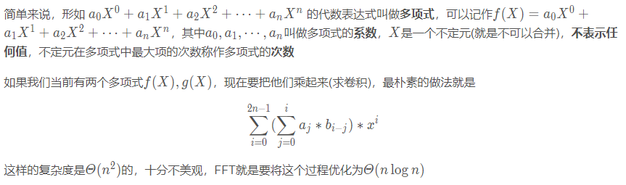
4.Maps for Creating Large Scale Benchmarks
Coarse alignment: （归一化+ FFT ）NCC + 高斯先验+穷举搜索
归一化：We rescale both aerial and ground images to [0,1] before NCC.
FFT： FFT（Fast Fourier Transformation）是离散傅氏变换（DFT）的快速算法。即为快速傅氏变换。它是根据离散傅氏变换的奇、偶、虚、实等特性，对离散傅立叶变换的算法进行改进获得的。
NCC（归一化交叉相关）用来描述两个目标的相关程度。NCC也会被用来进行图像匹配，即在一个图像中搜索与一小块已知区域的NCC最高的区域作为对应匹配，然后对准整幅图像。

Slide 23
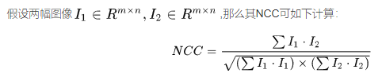
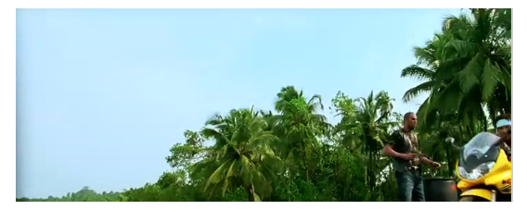
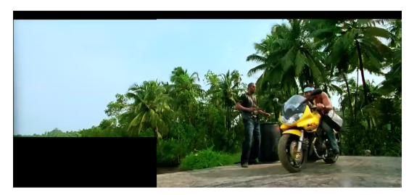
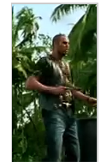
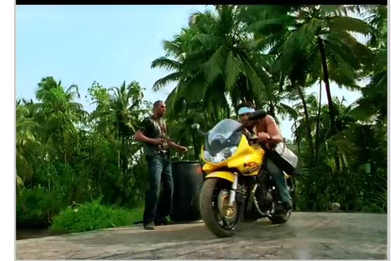
4.Maps for Creating Large Scale Benchmarks
Coarse alignment: （归一化+ FFT ）NCC + 高斯先验+穷举搜索
高斯先验+穷举搜索： a Gaussian prior with mean (0,0,2.5)m and diagonal covariance (2,2,0.2)m
The solution space is a discrete search window in the range [−10m,10m]×[−10m,10m]×[2.2m,2.6m] with a step of 0.1m.

Slide 24
4.Maps for Creating Large Scale Benchmarks
Fine alignment
Our ﬁne alignment then utilizes the road curves and aligns them to the boundary edges [10] in the panorama. We use a search area of [−1m,1m] × [−1m,1m] with a step of 5cm. This is followed by a human veriﬁcation process that selects the images where this alignment succeeds. Mistakes in the alignment are due to occlusions (e.g., cars in the panoramas) as well as signiﬁcant non-ﬂat terrain. Our success rate is 34.35%, and it takes less than 2s to verify an image. In contrast annotating the alignment takes 20s.

Slide 25
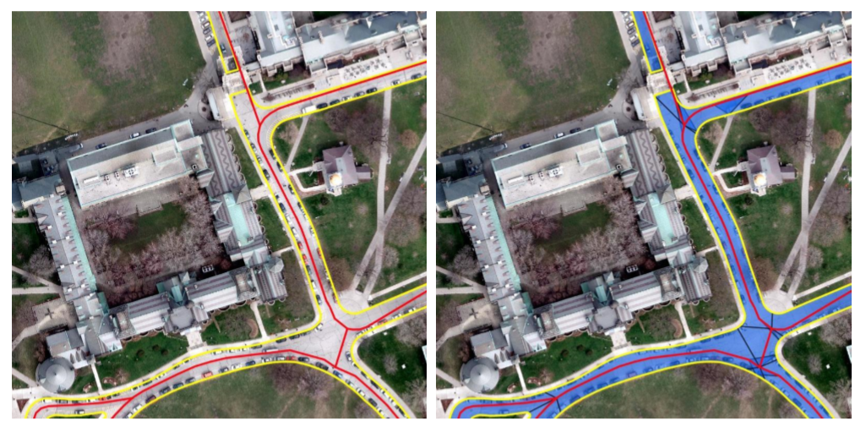
4.Maps for Creating Large Scale Benchmarks
4.2.Semantic Segmentation from Polyline Data
Our maps provide two types of road structures: curbs deﬁning the road bound aries as well as center lines deﬁning the connectivity (adjacency) in the street network.
Unfortunately, these two sources
are not aligned, and occasionally
center lines are outside the road area.
In this section we show our proce-
dure of exploiting a Markov random
ﬁeld (MRF) to align road centerlines
and curves. We can then generate
the polygons describing the road surf-
aces. Fig. 3 shows an example for the road surface generation.

Slide 26
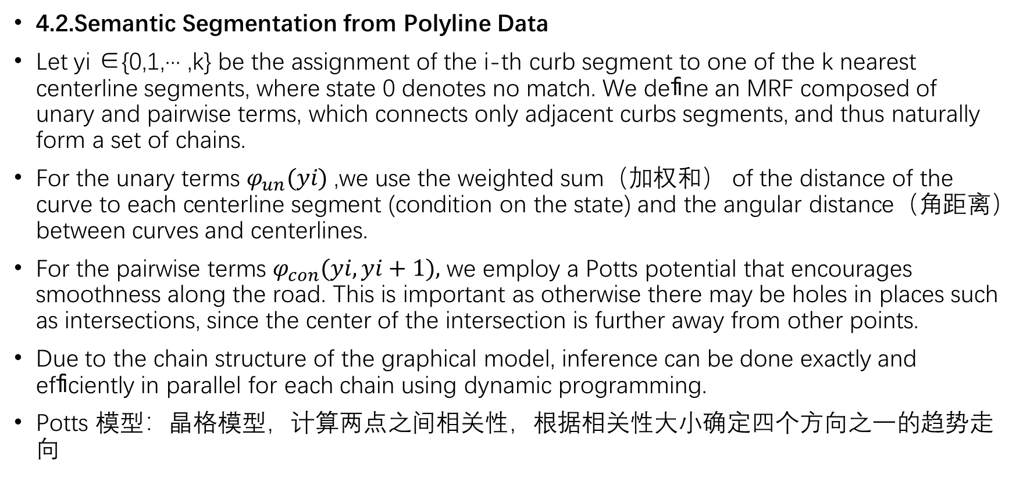
4.Maps for Creating Large Scale Benchmarks
4.2.Semantic Segmentation from Polyline Data
Let yi ∈{0,1,··· ,k} be the assignment of the i-th curb segment to one of the k nearest centerline segments, where state 0 denotes no match. We deﬁne an MRF composed of unary and pairwise terms, which connects only adjacent curbs segments, and thus naturally form a set of chains.
For the unary terms $φ_{un}(yi)$,we use the weighted sum（加权和） of the distance of the curve to each centerline segment (condition on the state) and the angular distance（角距离） between curves and centerlines.
For the pairwise terms $φ_{con}(yi,yi+1),$we employ a Potts potential that encourages smoothness along the road. This is important as otherwise there may be holes in places such as intersections, since the center of the intersection is further away from other points.
Due to the chain structure of the graphical model, inference can be done exactly and efﬁciently in parallel for each chain using dynamic programming.
Potts 模型：晶格模型，计算两点之间相关性，根据相关性大小确定四个方向之一的趋势走向

Slide 27
5.Benchmark Tasks and Metrics
We designed a diverse set of benchmarks to push computer vision approaches to reason about geometry, semantics and grouping.
In the evaluation server, participants can submit results using any subset of the imagery types provided in the benchmark (e.g., aerial images, panoramas, Go-Pro, stereo).
In this section, we brieﬂy describe the tasks and metrics, and refer the reader to the supplementary material for further details.
Building Footprint and Road segmentation ： Our ﬁrst task is semantic segmentation of building footprints and roads. Following common practice in semantic segmentation, we utilize mean Intersection-Over-Union (mIOU) as our metric. This is evaluated from a top-down view.
Building Footprint Instance Segmentation: Our second task is building instance segmentation. We adopt multiple metrics for this task, since there is no consensus in the community of what is the best metric. We thus evaluate weighted coverage(Cov),average precision(AP) as well as instance level precision and recall at 50%.

Slide 28
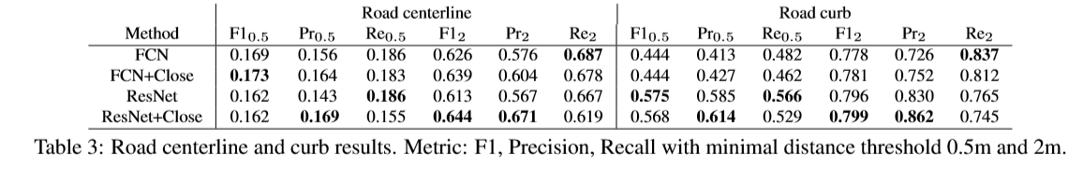
5.Benchmark Tasks and Metrics
Building Structured Contours: We want to push the community to produce instance segmentations that follow the structure of the primitives. Towards this goal, we deﬁne a metric that merges (in a multiplicative fashion) segmentation scoring with geometric similarity.
In particular, segmentation is measured in terms of IOU, and we exploit the similarity between the turning functions of the estimated and ground truth polygons as a geometric metric.
Road Topology：In this task, participants are asked to extract polylines that represent road curbs and road centerlines in bird’s eye perspective. We discretize（离散化） both estimated and ground truth polylines in intervals of size 10cm. We deﬁne precision and recall as our metrics, where an estimated segment is correct if its distance to the closest segment on the target polyline set is smaller than a threshold (i.e., 0.5m and 2.0m).

Slide 29
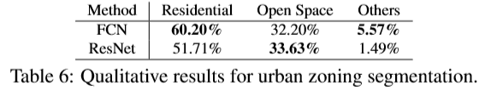
5.Benchmark Tasks and Metrics
Ground Road Segmentation: We use IOU as our metric
Ground Urban Zoning Classiﬁcation: This benchmark is motivated by the human’s ability to recognize the urban function of a local region by its appearance. We use Top-1 accuracy as our metric and evaluate on the ground view.
Urban Zoning Segmentation: Our goal is to produce a segmentation in bird’s eye view of the different urban zones including residential, commercial, open space, employment, etc. We utilize IOU as our metric.

Slide 30
5.Benchmark Tasks and Metrics
Building Height Estimation: This tasks consists on estimating building height. Useful cues include size of the buildings, pattern of shading and shadows as well as the imperfect rectiﬁcation in aerial views. We adopt root mean square error in the log domain (log-RMSE) as our metric.
Additional Tasks: We plan to add many tasks in the coming months. This includes detecting trees and recognizing their species.
Moreover, the accurate 3D building models allow us to build a benchmark of normal estimation as well as facade parsing.
We also plan to have benchmarks for detection and segmentation of trafﬁc lights, trafﬁc signs and poles.

Slide 31
6.Experimental Evaluation
We perform a pilot study of the difﬁculty of our tasks in a subset of TorontoCity, containing 125 km2 region (50 km2 fortraining,50 km2 for testing and 25km2 for validation).
The train/val/test regions do not overlap and are not adjacent. We utilize 56K streetview images around these regions (22K for training, 18K for validation and 16K for testing).
To perform the different segmentation related tasks, we train two types of convolutional networks: a variant of FCN-8 architecture [19] as well as a ResNet [14] with 56 convolutional layers.

Slide 32
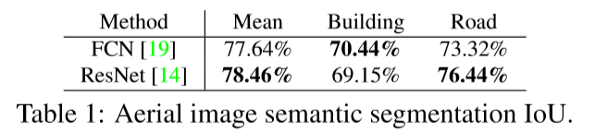
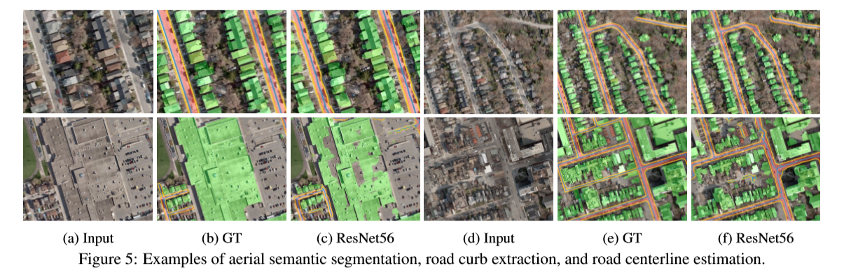
6.Experimental Evaluation
Semantic Segmentation: As shown in Tab.
1, both networks perform well. Fig. 5 illustr-
ates qualitative results of ResNet56 output. It
is worth noting that large networks such as ResNet56 can be trained from scratch given our largescale dataset. Visually ResNet’s output tends to be more sharp, while FCN’s output is more smooth.

Slide 33
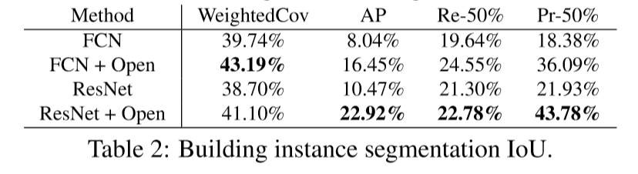
6.Experimental Evaluation
Instance Segmentation: We estimate instance segmentation by taking the output of the semantic labeling and performing connected-component labeling. Each component is assigned a different label. Since convolutional nets tend to generate blob like structures, a single component might contain multiple instances connected with a small number of pixels. To alleviate this problem, we apply morphological opening operators over the semantic labeling masks ( an erosion ﬁltering followed by a dilation ﬁltering with the same size). As shown inTab.2 and Fig.6 the performance is low. There is still much for the community to do to solve this task.

Slide 34
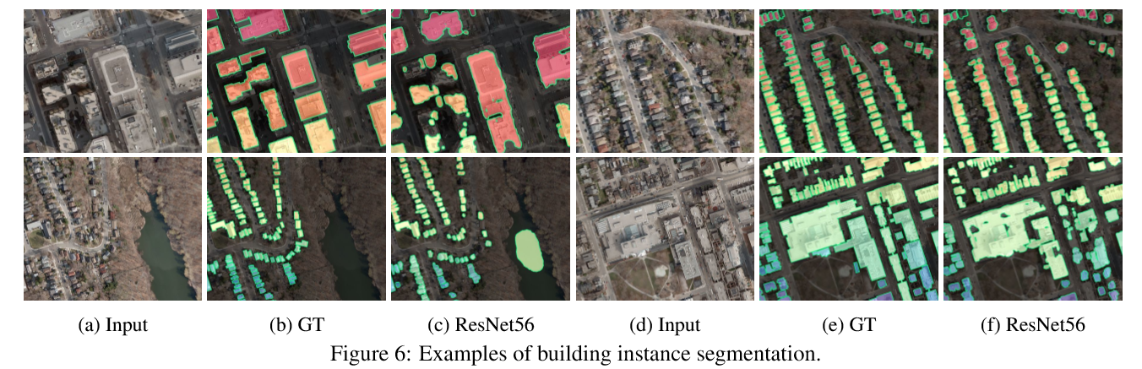
6.Experimental Evaluation
Instance Segmentation: We estimate instance segmentation by taking the output of the semantic labeling and performing connected-component labeling. Each component is assigned a different label. Since convolutional nets tend to generate blob like structures, a single component might contain multiple instances connected with a small number of pixels. To alleviate this problem, we apply morphological opening operators over the semantic labeling masks ( an erosion ﬁltering followed by a dilation ﬁltering with the same size). As shown inTab.2 and Fig.6 the performance is low. There is still much for the community to do to solve this task.

Slide 35
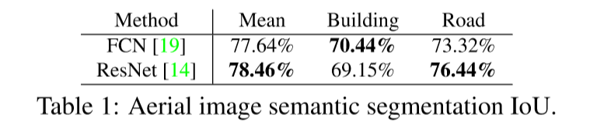
6.Experimental Evaluation
Road Centerlines and Curbs: We compute the medial axis of the semantic segmentation to extract the skeleton of the mask as our estimate of road centerline. In order to smooth the skeletonization, we ﬁrst conduct a morphological closing operator (dilation followed by erosion) over the road masks. To estimate road curbs, we simply extract the contours of the road segmentation and exploit closing operator. As shown in Table. 1, ResNet achieves the highest score in both tasks, and morphological ﬁltering helps for both networks. Qualitative results are shown in Fig.5. Note that there is still much room for improvement.
形态学算子：http://www.cnblogs.com/max198727/p/3696530.html

Slide 36
6.Experimental Evaluation
Road Centerlines and Curbs: We compute the medial axis of the semantic segmentation to extract the skeleton of the mask as our estimate of road centerline. In order to smooth the skeletonization, we ﬁrst conduct a morphological closing operator (dilation followed by erosion) over the road masks. To estimate road curbs, we simply extract the contours of the road segmentation and exploit closing operator. As shown in Table. 1, ResNet achieves the highest score in both tasks, and morphological ﬁltering helps for both networks. Qualitative results are shown in Fig.5. Note that there is still much room for improvement.

Slide 37
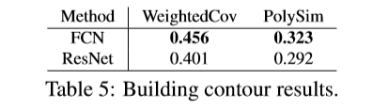
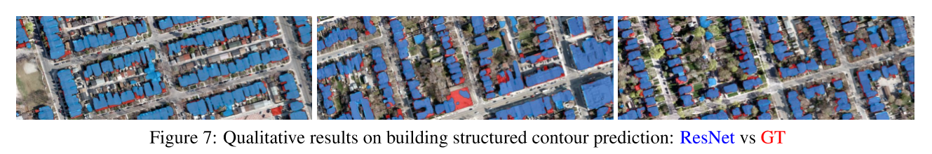
6.Experimental Evaluation
Building Contours: We compute building contours from our estimated building instances, and apply the Ramer-Douglas-Peucker algorithm [27] to simplify each polygon with a threshold of 0.5m. This results in polygons with 13 vertices on average. As shown in Tab. 5 and Fig. 7, this simple procedure offers reasonable yet not satisfactory resulst. This suggests there is still a large improvement space for generating building polygons from aerial images.

Slide 38

6.Experimental Evaluation
Ground Urban Zoning Classiﬁcation: We train multiple state-of-the-art convolutional networks for this task including AlexNet [16], VGG-16 [32], GoogleNet [33] and ResNet-152 [14] that are ﬁne-tuned from the ImageNet benchmark [9]. We also train AlexNet [16], ResNet-32 [14], Network-In-Network [17] and ResNet-152 [14] from scratch over our ground-view panoramic image tiles. As shown in Table. 1 ResNet-152 with pre-trained initialization achieves the best results. Net-in-net achieves the best performance among all models that are trained from scratch.
Urban Zoning Segmentation: This is an extremely hard task from aerial views alone. To simplify it, we merged the zone-types into residential, others (including commercial, utility and employment) as well as open spaces (including natural, park, recreational etc.). As shown in Tab. 4 more research is needed to solve this task.

Slide 39
6.Experimental Evaluation
Ground-view road segmentation: We utilize a subset of the labeled panoramas, which includes 1000 training, 200 validation and 800 testing images. The average IOU is 97.21%. The average pixel accuracy is 98.64% and average top-down IOU is 87.53%. This shows that a state-of-the-art neural network can nearly solve this task, suggesting that it is promising to automatically generate high-resolution maps by capturing geo-referenced street-view panoramas.
Building Height: No network was able to estimate building height from aerial images alone. This task is either too hard, or more sophisticated methods are needed. For example, utilizing ground imagery seems a logical ﬁrst step.

Slide 40
ImageNet： https://blog.csdn.net/xingwei_09/article/details/79148294
Alex-Net: https://blog.csdn.net/guoyunfei20/article/details/78122504
PASCAL VOC: https://blog.csdn.net/weixin_35653315/article/details/71028523
Microsoft COCO: https://www.cnblogs.com/geekvc/p/6657369.html
Cityscapes: https://www.cityscapes-dataset.com/examples/
KITTI: http://www.cvlibs.net/datasets/kitti/index.php
NCC: https://www.cnblogs.com/YiXiaoZhou/p/5998153.html
FFT： https://blog.csdn.net/WADuan2/article/details/79529900
Potts: https://en.wikipedia.org/wiki/Potts_model
形态学算子：http://www.cnblogs.com/max198727/p/3696530.html

